Slide 1

Performance Testing - Putting Cloud Customers Back in the Driver’s Seat
Imad Mouline - CTO, Gomez, The Web Performance Division of Compuware
@imadmouline
Ryan Breen – VP Technology, Gomez, The Web Performance Division of Compuware

Slide 2
The Impact of Web Performance on Page Abandonment
Performance improvement (seconds)
As pages speed up…
Percentage change in page abandonment
… abandonment decreases
Source: Gomez 2010 Study of 500 Million End-User Interactions Across 200+ Web Sites

Slide 3
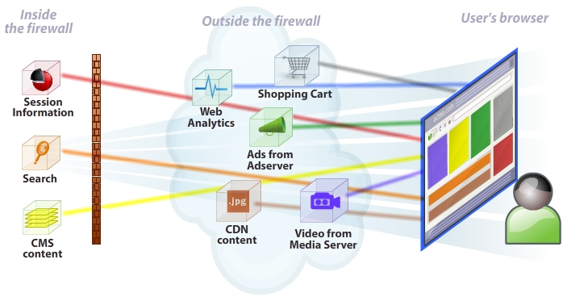
Web Applications Are Increasingly Composite

Slide 4
By The Numbers
Number of hosts accessed directly by the browser, per user transaction, averaged across 3,000 companies
Measurement city | Number of hosts per user transaction
Hong Kong | 7.56
Beijing | 8.57
London | 8.59
New York | 8.85
Frankfurt | 8.87
Notes:
Objects per page
345 San Jose, CA - AT&T 7.266057
131 Quarry Bay, Hong Kong - CPCNet 7.564671
247 London, UK - Global Crossing 8.594765
267 Beijing,China - China Unicom 8.569770
171 New York, NY - Sprint 8.852465
203 Munich, Germany - Telefonica 10.414258
212 Frankfurt, Germany - Deutsche Telekom 8.874623

Slide 5
Web Applications Are Moving To The Cloud
Percentage of web app transactions that include at least one object hosted on Amazon EC2
Amazon EC2 Region | Percentage
EC2 Asia Pacific - Singapore | 0.002
EC2 US West - Northern California | 0.659
EC2 EU - Ireland | 2.733
EC2 US East - Northern Virginia | 16.194
TOTAL | 19.588
Notes:
Web applications are moving to the cloud - Percentage of web app transactions that include at least one object hosted on Amazon EC2
So for 1 hr:
42,368 unique tests
1,010,751 unique test & Ips
USEast USWest EUIreland AsiaPacSin AzureUSSouthCentral AzureUSNorthCentral AzureEUNorth AzureAsiaSoutheast
----------- ----------- ----------- ----------- ------------------- ------------------- ------------ ------------------
6861 279 1158 1 62 24 77 12

Slide 6
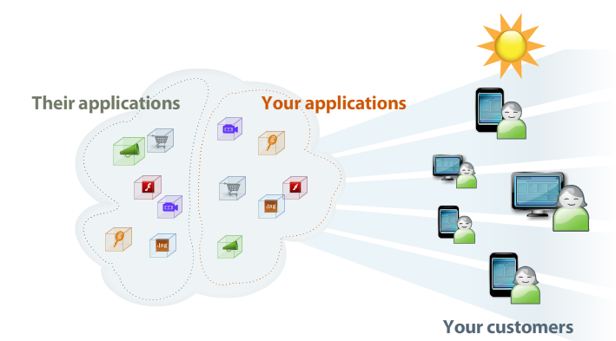
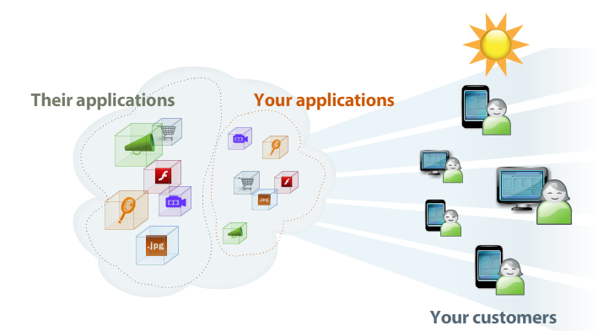
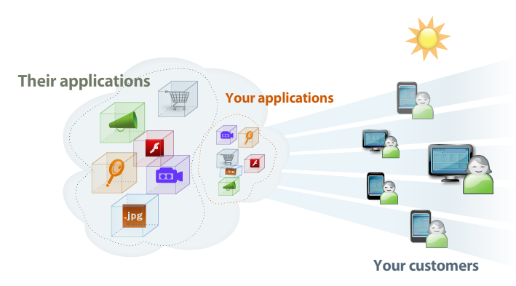
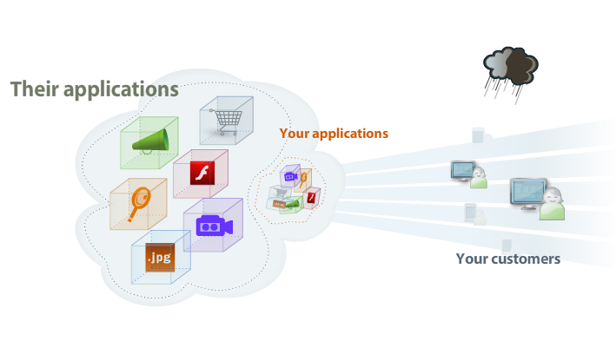
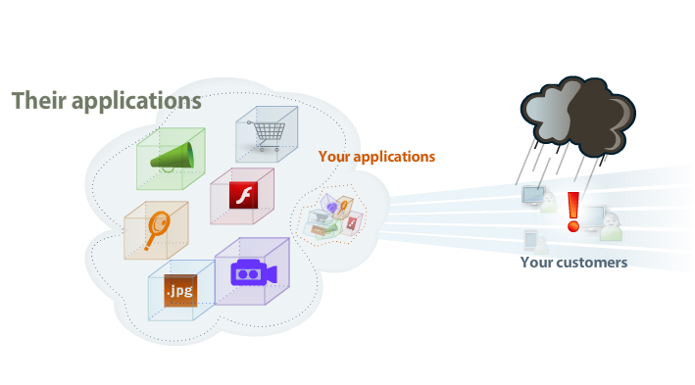
The Cloud Creates Performance Concerns
The Cloud is opaque & shared
  Loss of visibility and control - traditional tools don’t apply
  Others can affect my performance

Slide 7
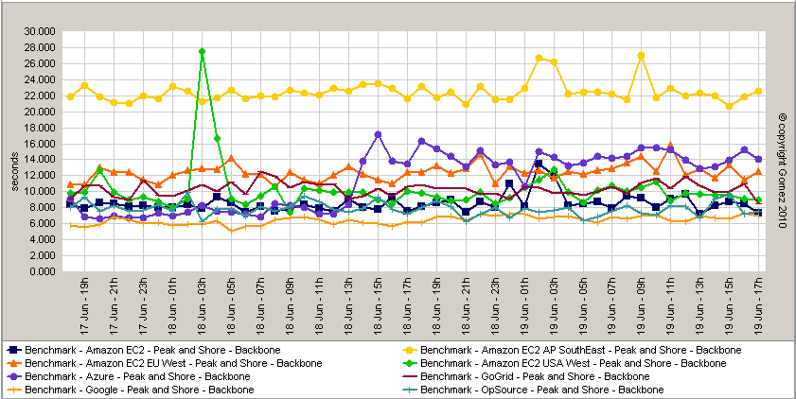
Not All Clouds Are Created Equal – Speed
Average response time of reference app transaction across various Cloud providers, measured from several global locations

Slide 8
Not All Clouds Are Created Equal – Availability
Aggregate average availability of reference app on Opsource, Amazon EC2 US East, Amazon S3, GoGrid & Google AppEngine measured from global backbone locations
Notes:
Opsource static Amazon EC2 US East Static Amazon S3 Static GoGrid Static Google AppEngine Static

Slide 9
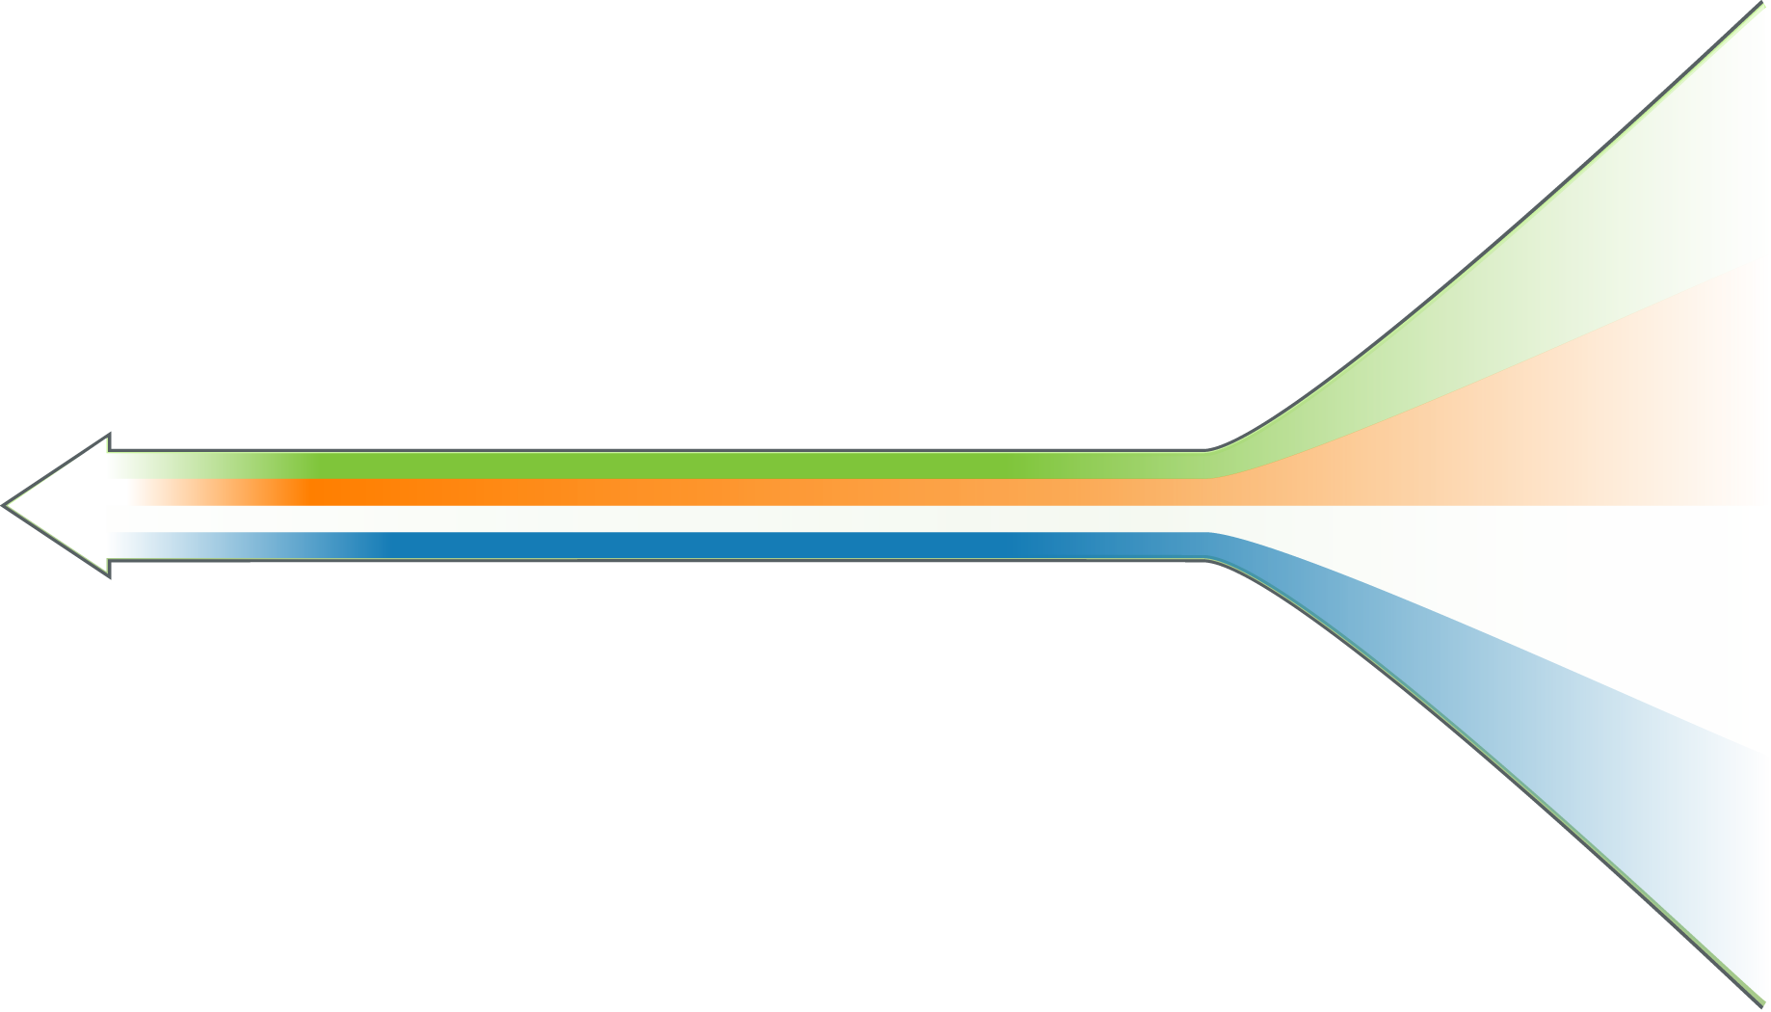



































The Cloud Is Opaque:
How do you know if your application is really performing?
The Web Application Delivery Chain
My users
3rd Party/
Cloud Services
Browsers and devices
Load
Balancers
Local ISP
Web
Servers
Other
users
Mobile
Components
Cloud
Solution = “Outside-in” customer point of view
App
Servers
Other
users
Internet
DB
Servers
Major
ISP
Storage
Mainframe
Other
users
Network
Content Delivery
Networks
Mobile
Carrier

Slide 10




The Cloud Is Shared
How Do You Know It’s Your Issue Or Your Cloud Provider’s?
The Web Application Delivery Chain
My users
Cloud is shared
3rd Party/
Cloud Services
Browsers and devices
Load
Balancers
Local ISP
Web
Servers
Other
users
My app
Other
app
Mobile
Components
Cloud
Solution = Collective Intelligence
App
Servers
Other
users
Internet
Other
app
Major
ISP
DB
Servers
Storage
Other
app
Mainframe
Other
users
Network
Content Delivery
Networks
Mobile
Carrier
Multiple contributors help diagnose issues for everyone

Slide 11
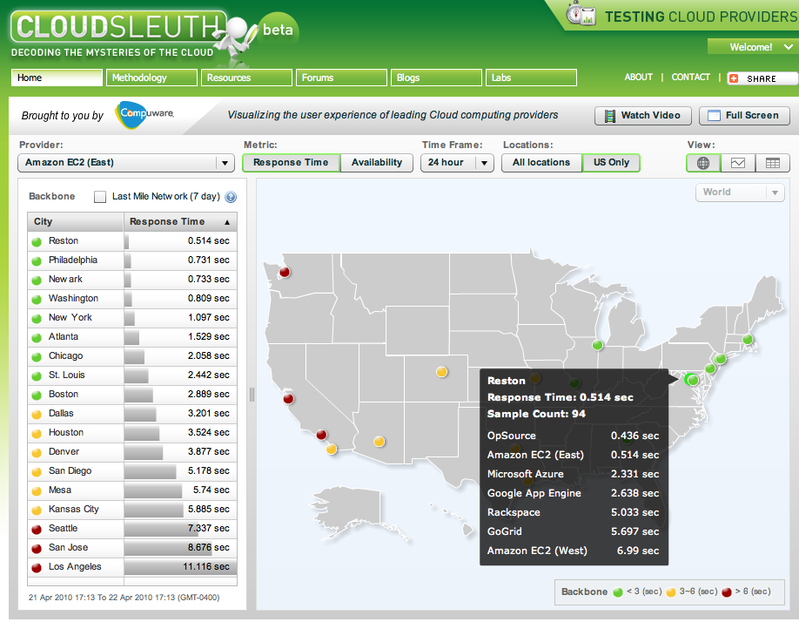
Introducing… The CloudSleuth Community
Get free monitoring of your cloud application with cloudsleuth.net
Contribute to the community’s visibility into cloud vendor performance

Slide 12

The Cloud Offers Unique Opportunities For Optimization
Domain sharding is a common performance optimization
In traditional hosting environment, it came at a price
The Cloud, with proper planning, can provide sharding for free
    Potential bottleneck
Bucket 1
Bucket 2

Slide 13
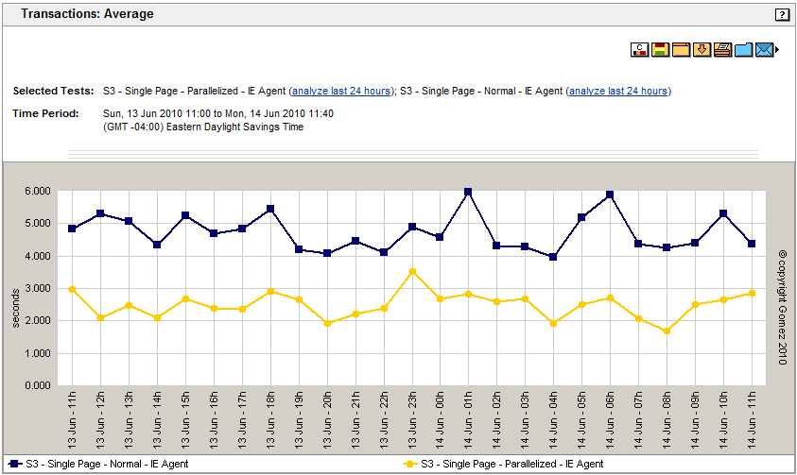
The Cloud Offers Unique Opportunities For Optimization
Better performance, for little work, at no extra cost?
Notes:
Enough scary news -

Slide 14
The Cloud Is Prepared For The Unknown
Faced with constraints anywhere upstream from the browser, the cloud offers unique opportunities to expand capacity.
    Potential bottleneck
Instance
Instance
    Dynamically provisioned
    @ capacity
Notes:
I think we want something that looks more like a stack of browsers on the left with some of that stack peeled off to hit a newly spun up instance. So, the top instance on the right might be @capacity, and the bottom one might say something like 'dynamically provisioned'.
Also, in this case we want to make clear that the right hand side is your potential bottleneck.

Slide 15
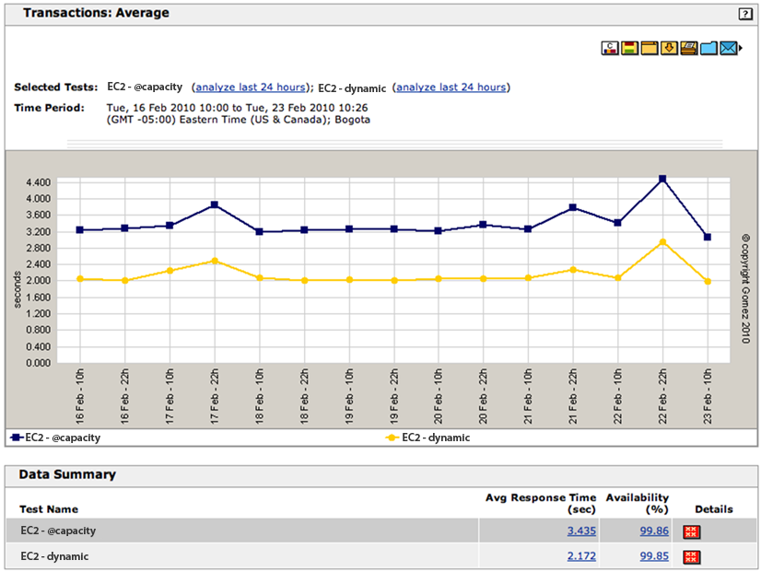
The Cloud Helps You Prepare For The Unknown
Notes:
Unique opp for optimization – Munich

Slide 16
Impact Of Optimization Across Browsers & Mobile Devices
Yesterday’s optimizations must be constantly revalidated
  Sharding fails to show benefit on modern browser
  And sharding shows a substantial performance hit on mobile devices such as the iPad
 | Major News Site Sharded (response time = seconds) | Major News Site Non-Sharded (response time = seconds)
Internet Explorer 7 | 3.917 | 3.995
Firefox 3.5 | 4.033 | 3.797
iPad | 24.470 | 23.821
Notes:
Shard Non-shard
IE 3.917 3.995
FF 4.033 3.797
iPad 24.470 23.821
ajaxperformance.com-MSNBC.com-non-sharded at 23.821
ajaxperformance.com-MSNBC.com-normal at 24.470

Slide 17




Significant Performance Differences Across Browsers/Devices
Source: Gomez Real-User Monitoring
    Real users around the world
    Broadband connections only
    466 million page measurements
    200+ sites

Slide 18
Key Takeaways
Applications are getting more composite, and many are already using the Cloud, for good or bad
The Cloud offers new opportunities for performance optimization
  Beware yesterday’s optimization techniques – some may backfire
  It is critical to test and monitor your optimizations across browsers, devices, and geographies
Collective Intelligence-driven analysis will become increasingly critical in performance monitoring and optimization

Slide 19
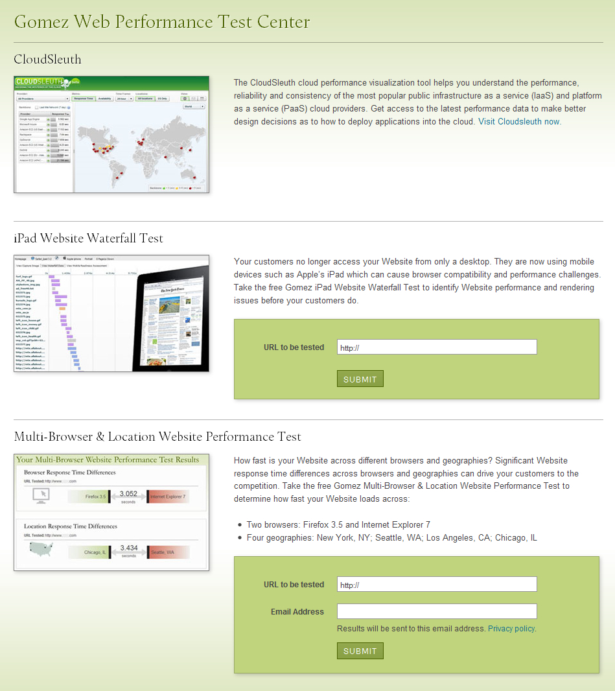
Go to: gomez.com/velocity
gomez.com/velocity
  Cloudsleuth
    Cloud performance visualization
  iPad Website Waterfall Test
    Object level Website performance analysis using iPad
  Multi-Browser & Location Website Performance Test
    Website load time across 2 browsers and 4 locations

